Slide 1
CMSC 304
Syntactic Structure
Claire Sparks

Slide 2
Introduction
Syntax: the form or structure of the expressions, statements, and program units
Semantics: the meaning of the expressions, statements, and program units
Syntax and semantics provide a language’s definition
  Users of a language definition
    Other language designers
    Implementers
    Programmers (the users of the language)
Notes:
Syntax for compile time
Semantics for runtime

Slide 3
Syntax Analysis of Code
Two phases:
  Scanning: lexical structure
  Parsing: syntactic structure
Lexical structure: the structure of the terminals (tokens) in a language
Syntactic structure: the structure of a derivation from a language

Slide 4
Syntactic Structure
We need a way to attach semantics to syntax since the meaning of a structure is related to its syntax
The process of associating the semantics of a construct to its structure is called syntax-directed semantics
  Construct syntax so that it reflects the semantics we will eventually attach to it
  Need a way of expressing this structure as determined by a derivation
  Standard way to do this is with a parse tree

Slide 5
Parse Trees
Parse tree: graphical depiction of the replacement process in a derivation
  Labeled by nonterminals at interior nodes (nodes with at least one child)
  Labeled by terminals at leaves (nodes with no children)
  Structure is completely specified by the grammar rules of the language and a derivation of a particular sequence of terminals

Slide 6
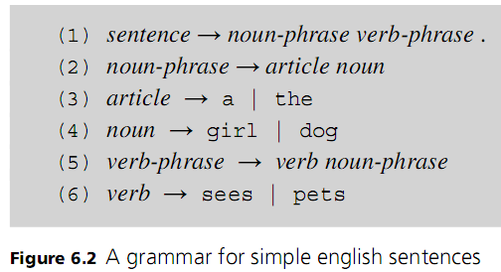
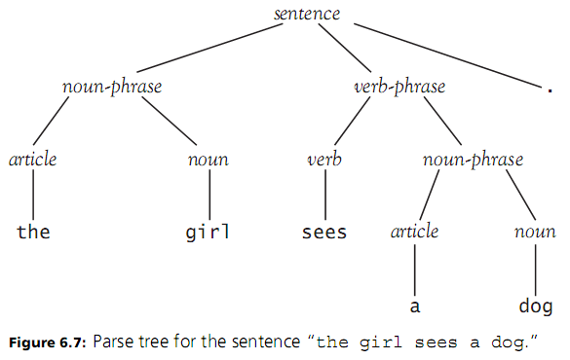
Parse Trees
Notes:
Do derivation demo

Slide 7
Parse Trees
Notes:
Do derivation demo

Slide 8
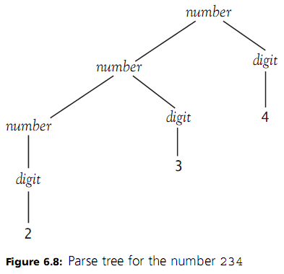
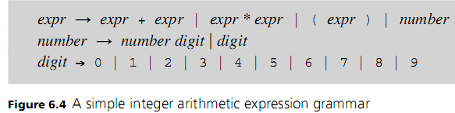
Parse Trees
Notes:
Do derivation demo

Slide 9
Parse Trees
Parse trees are considered concrete syntax
  A representation of the entire parsed input
We represent the syntax of an expression as a tree so we can attach semantics to it
But parse trees can be very large and verbose
  Not all terminals and nonterminals are needed to determine the meaning of a given expression

Slide 10
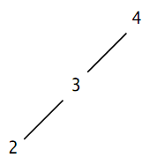
Abstract Syntax Trees
Abstract syntax tree: a tree that abstracts away the nonessential structure of the parse tree
  An AST is a condensed view of the parse tree
  This condensed tree expresses a language’s essential syntactic structure
    The full, concrete syntax isn’t necessary to express this
  Easier to attach semantics to a condensed AST than a parse tree

Slide 11
Abstract Syntax Trees
How do we convert a parse tree into an abstract syntax tree (AST)?
Remove all structure defining symbols
Remove all single-successor nodes
  Single-Successor Node: A node with a single child
Make operator tokens nonterminal nodes
Notes:
Stronger explanation coming up in two slides

Slide 12
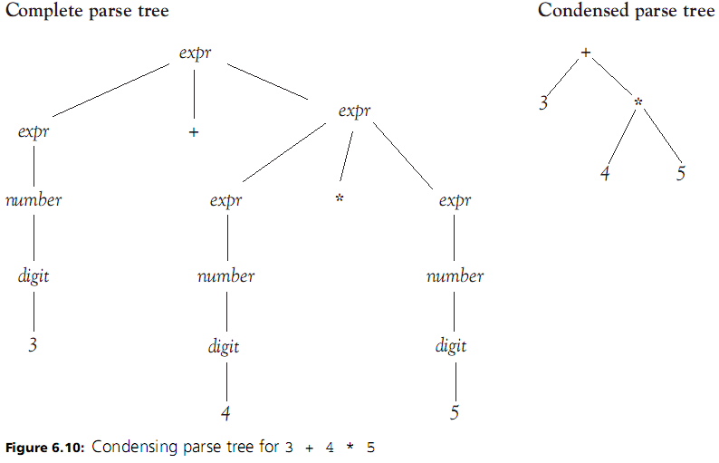
Abstract Syntax Trees
Notes:
Remove all single-successor nodes
Single-Successor Node: A node with a single child
Remove all structure defining symbols
Make operator tokens nonterminal nodes

Slide 13
Abstract Syntax Trees
Notes:
Remove all single-successor nodes
Single-Successor Node: A node with a single child
Remove all structure defining symbols
Make operator tokens nonterminal nodes

Slide 14
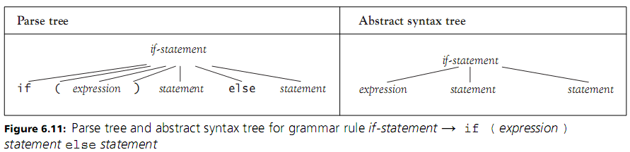
Abstract Syntax Trees
Abstract syntax trees (or syntax trees): trees that abstract away the nonessential structure of the parse tree
  Do away with terminals unnecessary for expressing essential syntactic structure
Notes:
Here's examples of structure defining symbols. Here's a rule
What on the parse tree is structure defining and can be removed
the parenthesis, the if, and the else, because they are key words, they don't DO anything
note that many times in computer generated ASTs, these pieces are encoded in the names of instance variables
If the if statement is the parent, the first part HAS to be the expression, the second child HAS to be a statement, and the third statement HAS to be a statement

Slide 15
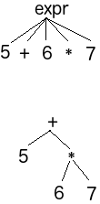
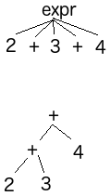
Abstract Syntax Trees
When converting a parse tree into an AST, how do we handle nodes with multiple operator children?
If operators are of a differencing precedence:
  Make lower precedence operator the parent
Else if the operators are not of a differencing precedence:
  Make right child operator the parent
The other operator will become a child of the first operator and it’s neighboring nodes will become it’s children

Slide 16
Ambiguity, Associativity, and Precedence
Syntax and semantics can become interdependent when semantic information is required to distinguish ambiguous parsing situations
Ambiguous parsing situations are problematic
  They lead to an expression having different meanings for different derivations
Ideal to design syntax which makes attaching semantic meaning as painless as possible
Notes:
Ambiguity happens in natural language, but is catastrophic in programming (because computers a dumb hunks of silicon that can’t guess!)

Slide 17
Ambiguity, Associativity, and Precedence
However, can have ambiguous grammars such as:
Ambiguous Grammar: one for which two distinct parse or syntax trees are possible
How is this grammar ambiguous?

Slide 18
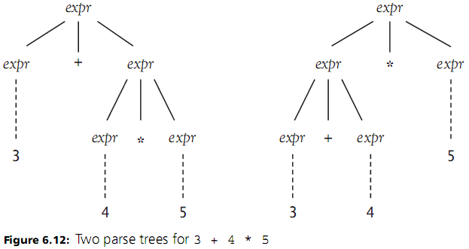
Ambiguity, Associativity, and Precedence
However, can have ambiguous grammars such as:
3+4*5

Slide 19
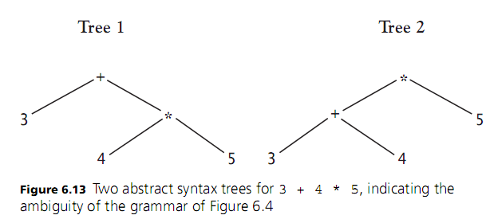
Ambiguity, Associativity, and Precedence
Abstract syntax tree showing ambiguous grammar:
Notes:
These two syntax trees have totally different meanings.
Tree 1: 23
Tree 2: 35

Slide 20
Ambiguity, Associativity, and Precedence
Can use concept of testing a grammar with a certain special derivation to see if derivations constructed in a special order can produce two different parse trees
One such special derivation is called leftmost derivation
  In this derivation, the leftmost remaining nonterminal is singled out for replacement at each step
If using a special derivation, you get two parse trees for the same string, then the grammar is ambiguous

Slide 21
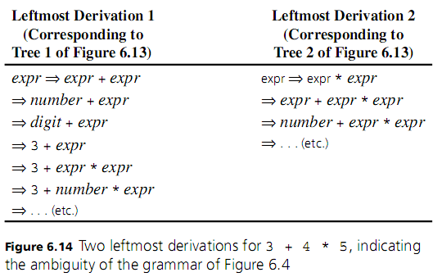
Ambiguity, Associativity, and Precedence
Ex:
Notes:
Two separate derivations
Ambiguous cause of the first rule → we can break an expr nonterminal into either an expr + expr or expr *expr

Slide 22
Ambiguity, Associativity, and Precedence
How do we remove the ambiguities?
How do we make multiplication take precedence over addition?
  State a disambiguating rule separately from the grammar
  Revise the grammar to remove the ambiguity
    Establish a precedence cascade to force the matching of the “*” at a lower point in the parse tree
    Instead of:
    expr -> expr + expr | expr * expr | (expr) | NUMBER
    We have:
      expr → expr + expr | term
      term → term * term | (expr) | number
Notes:
Show revised grammar on next slide

Slide 23
Ambiguity, Associativity, and Precedence
expr → expr + expr | term
term → term * term | (expr) | number
number → number digit | digit
digit → 0 | 1 | 2 | 3 | 4 | 5 | 6 | 7 | 8 | 9
Notes:
Resolves the multiplication ambiguity
We have not completely solved the ambiguity problem, however, because the rule for an expr still allows us to parse 3 + 4 + 5
as either
(3 + 4) + 5 || 3 + (4 + 5)
**Next Slide**

Slide 24
Ambiguity, Associativity, and Precedence
Modified grammar removes ambiguity around multiplication
expr → expr + expr | term
term → term * term | (expr) | number
number → number digit | digit
digit → 0 | 1 | 2 | 3 | 4 | 5 | 6 | 7 | 8 | 9
3+4*5

Slide 25
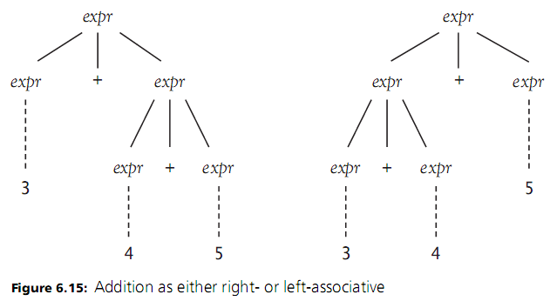
Ambiguity, Associativity, and Precedence
Does the cascading precedence fix the problem?
3+4+5
Still have two parse trees when just adding
expr → expr + expr | term
term → term * term | (expr) | number
number → number digit | digit
digit → 0 | 1 | 2 | 3 | 4 | 5 | 6 | 7 | 8 | 9
Notes:
3 + 4 + 5
In other words, we can make addition either right- or left-associative
Which doesn’t change the outcome of the addition, but it shows our grammar is still ambiguous

Slide 26
Ambiguity, Associativity, and Precedence
Does the cascading precedence fix the problem?
Let’s do subtraction instead of addition:
  expr -> expr - expr | term
  term -> term * term | ( expr) | number
Problems for e.g. 5-4-3
  Depends if you use left- or right-associative
  Are we doing (5 - 4) - 3 or 5 - (4 - 3)
  Is it -2, or 4?
Notes:
But if we were to add subtraction to our grammar, we would have serious issues due to the ambiguous nature of our grammar.

Slide 27
Ambiguity, Associativity, and Precedence
One Possible Solution:
For subtraction:
  expr -> expr - term | term
  term -> term * factor | factor
  factor -> ( expr) | number
Left-associate solution
  5 - 4 - 3 becomes (5 - 4) - 3
Notes:
Define subtraction as explicitly left associative in the grammar

Slide 28
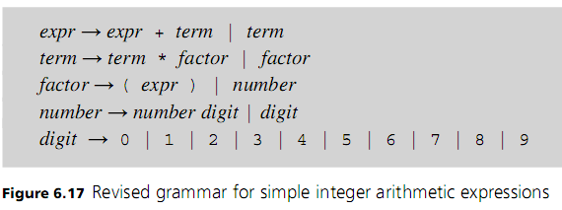
Ambiguity, Associativity, and Precedence
Notes:
So if we make those changes using addition rather than subtraction…
This makes the grammar unambiguous
Remember, we only have rules to deal with addition and multiplication. This Grammar doesn’t support division or subtraction (or anything else for that matter)
This recursiveness is kind of obnoxious, and has issues in automated parsing, because you could potentially have an infinite recursive loop. We humans can look ahead and look ahead. But if only look at one terminal at a time, that's an issue. A computer can't look an infinite number of terms ahead.
And recursion makes parse trees look ugly

Slide 29
Ambiguity, Associativity, and Precedence
Notes:
Actually do the parse tree here if you have time to show it? Or just make a new slide?

Slide 30
EBNF
Extended Backus-Naur form (or EBNF): introduces new notation to handle common issues
  Examples: number → number digit | digit
  generates: number=> number digit
  number digit digit
  number digit digit digit
  …
  Or expr → expr + term | term
  generates: expr => expr + term
  expr => expr + term + term
  expr => expr + term + term + term …
Notes:
Standard BNF given on this slide

Slide 31

EBNF
Extended Backus-Naur form (or EBNF): introduces new notation to handle common issues
Use curly braces to indicate 0 or more repetitions
  Assumes that any operator involved in a curly bracket repetition is left-associative
  Example:
Use square brackets to indicate optional parts
  Example:
Notes:
Similar to regular expressions, curly braces represent repetitions, square brackets to indicate optional parts

Slide 32
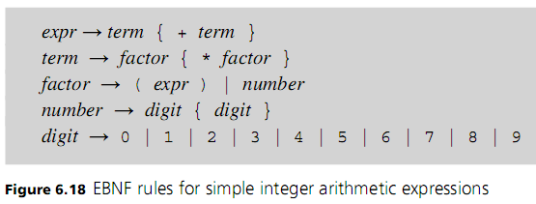
EBNF
Notes:
Converting our grammar to extended Backus-Naur form

